Slide 1

Fridge Temperature Controller Using Python
Presented by :
D. Sai Nikhilesh
Batch No : 504

Slide 2
About Me
Background:
I completed my Bachelor of Technology in CSE(AI-ML) from Gitam University
Why you want to learn Data Science:
I want to learn Data Science because I want to get a high payable job in feature
Any work experience:
So, far I have no experience
LinkedIn : https://www.linkedin.com/in/sai-nikhilesh-0a4581361/
GitHub

Slide 3
Agenda
Introduction
Business Problem
Objective of the Project
Concepts Used
Working of the System
Working Of Methods
Execution of Code
Conclusion
Q&A Slide

Slide 4
Introduction
A Smart Fridge System is a digital simulation of a refrigerator that allows users to monitor and control temperature using programmed commands, similar to real modern appliances.
The purpose of this project is to implement a simple fridge control system using Python while applying Object-Oriented Programming concepts like classes and inheritance
This project has real-world relevance as it mimics how actual refrigerators maintain temperature limits, provide preset modes (like quick freeze), and offer user-friendly control systems for efficient cooling and food preservation.

Slide 5
Business Problem
Modern households and commercial kitchens need precise temperature control to keep food fresh, safe, and energy-efficient. Traditional refrigerators require manual adjustment and lack intelligent modes.
So, the business wants to build a Smart Refrigerator System that:
Allows users to monitor temperature
Let's users adjust temperature easily
Provides predefined modes for convenience (Quick Freeze, Normal Mode)
Prevents invalid temperature settings (too high or too low)

Slide 6
Objectives
The main objective of this project is to simulate a refrigerator temperature control system where users can increase, decrease, and monitor temperature within defined limits.
It also aims to apply Object-Oriented Programming (OOP) concepts such as classes, inheritance, and method to design a structured and reusable system.
Additionally, the project focuses on building an interactive menu-driven application that allows users to control the fridge easily, similar to a real-life control panel.

Slide 7
Concepts Used
Object-Oriented Programming (OOP) - Organizes the system into classes and methods for modularity and reusability.
Classes & Objects - Fridge and SmartFridge classes define the fridge structure and behavior; objects represent individual fridge instances.
Inheritance - SmartFridge inherits from Fridge to reuse and extend functionality, demonstrating code reuse.
Conditional Statements - Used to enforce temperature limits and handle different menu options.
Loops - Keeps the menu running continuously, allowing multiple userinteractions until exit.

Slide 8
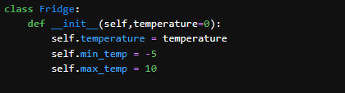
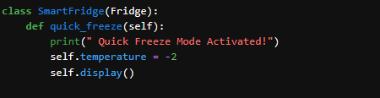
In this part of code, I have used OOPs concept by create a class
In this part of code, I have used Inheritance concept by inheriting the parent class into child class

Slide 9
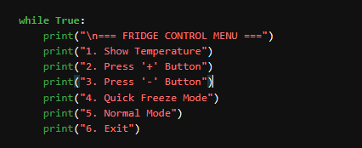
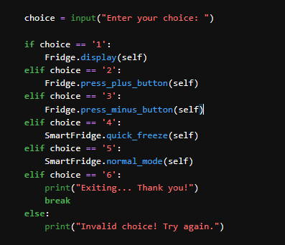
I used a while loop in this part of the code, which allows the program to keep running until the user stops it.
In this part of the code, I have used conditional statements to control the flow based on conditions.

Slide 10
Working of the Program
The program is menu-driven, displaying options like showing temperature, adjusting it, or activating modes.
The user selects an option by entering a number corresponding to the desired action.
The system performs the chosen action, such as increasing/decreasing temperature or switching to Quick Freeze/Normal mode.
A continuous loop (while True) ensures the menu keeps running, allowing multiple operations until the user chooses to exit.

Slide 11
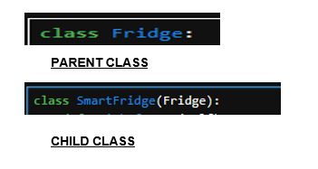
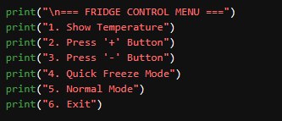
I have used two different class and I one is Parent class and another is Child class
As this is menu driven code the user can select the option which are given in code while execution
MENU GIVEN IN THE CODE

Slide 12
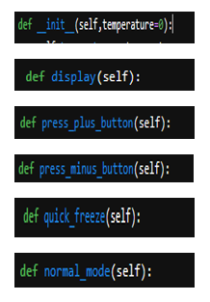
I used different methods in a classes to combine data and behavior into a single, organized unit (an object), which provides structure, reusability, and easier maintenance for complex programs
DIFFERENT METHODS USED IN PROGRAM

Slide 13
WORKING OF METHODS
Display Temperature – User can view the current fridge temperature at any time.
Increase/Decrease Temperature – Adjust the fridge temperature within safe limits using the + or - buttons.
Quick Freeze Mode – Instantly sets the fridge temperature to a low preset value
(-2°C) for rapid cooling.
Normal Mode – Resets the fridge to a standard cooling temperature (2°C).
Exit System – Safely ends the program when the user selects the exit option.

Slide 14
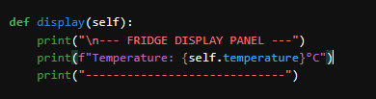
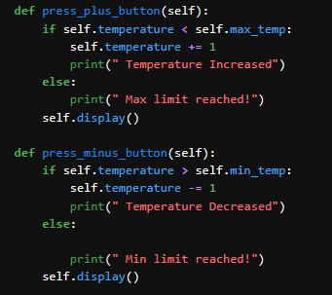
In this method, I have written code that allows the user to view the Temperature On The Display.
METHOD 1
In methods 2 and 3, I have written code that allows the user to control the Temperature By Increasing It By 1 Or Decreasing It By 1.
METHOD 2 AND METHOD 3

Slide 15

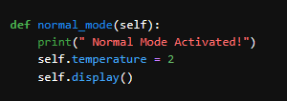
In this method, I have written code that allows the user to activate Quick Freeze mode.
METHOD 4
In this method 5, I have written the code that allows the user to quickly active Normal mode
METHOD 5

Slide 16
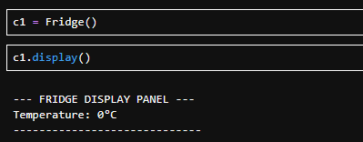
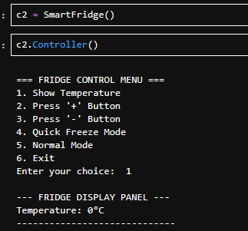
Execution Of The Code
In this I have called Parent class and displayed Temperature using display method
In this I have called the Child class and displayed the menu and here user can select the option present in this menu and user selected option 1 to display Temperature

Slide 17
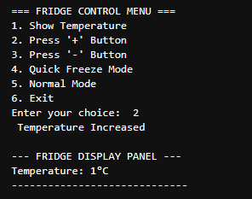
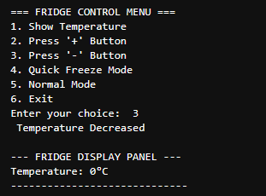
Here the user selected the option 2 and the temperature got increased 1
Here the user selected the option 3 and the temperature got decreased 1

Slide 18
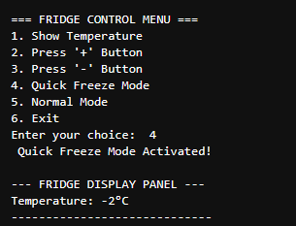
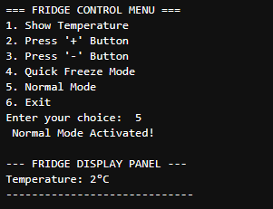
Here the user selected the option 4 and Quick Freeze Mode got Activated
Here the user selected the option 5 and Normal Mode got Activated

Slide 19
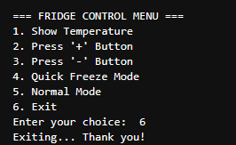
Here, the user selected option 5 and exited the loop.

Slide 20
Conclusion
The project successfully implemented Object-Oriented Programming (OOP) concepts, including classes, inheritance, and method reuse.
An interactive fridge system was built, allowing users to control temperature, switch modes, and view status through a menu-driven interface.
The system demonstrates real-world application, simulating how modern refrigerators maintain temperature limits, provide preset modes, and ensure safe food storage.

Slide 21
Q&A

Slide 22

THANK YOU

